Slide 1


A DATA-DRIVEN APPROACH TO OPTIMIZING STOCK & COSTS
INVENTORY MANAGEMENT SOLUTIONS
This presentation demonstrates how I built and analyzed an inventory management dashboard in Power BI. The goal was to optimize stock levels, improve supplier performance, and reduce costs using real-world inventory practices.
Presented By Renu Rani

Slide 2
TABLE OF CONTENT
1
4
Implementing Technology Solutions
Introduction
2
Assessing Current Inventory Practices
5
Enhancing Supplier Relationships
3
Optimizing Inventory Levels
6
Monitoring and Reporting
The Flow of my presentation , I’ll begin with an introduction, then assess current inventory practices, move into optimization techniques, supplier collaboration, and finally show how Power BI reporting supports decision-making.

Slide 3
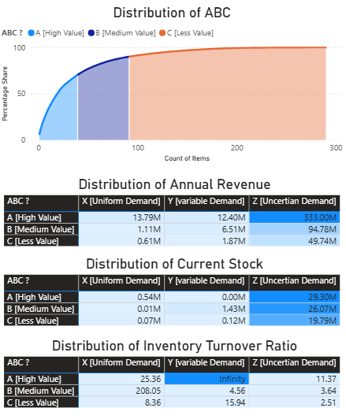
INTRODUCTION
“In this project, I analyzed SKU-level data containing stock quantity, unit price, weekly demand, lead time, and revenue. Using Power BI, I developed dashboards covering revenue contribution, ABC classification, turnover ratio, safety stock, reorder points, and supplier analysis. The purpose was to identify inefficiencies and recommend improvements.”

Slide 4
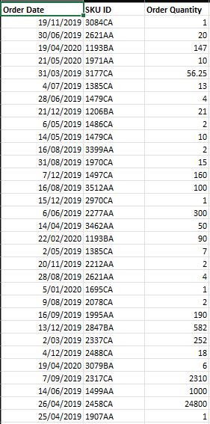
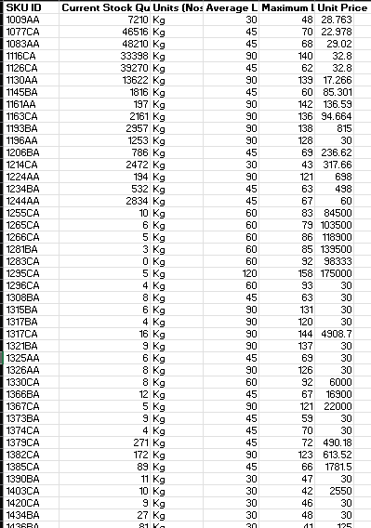

OVERVIEW OF DATA SETS

Slide 5

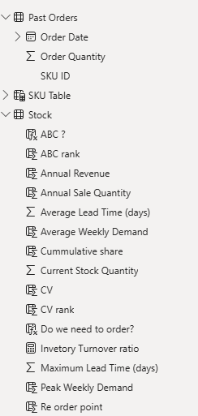
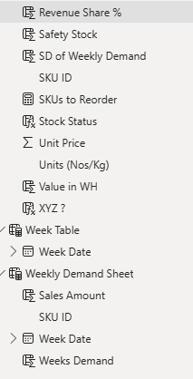

Data Cleaning, processing and transformed in Power Bi

Slide 6





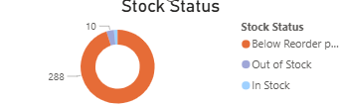
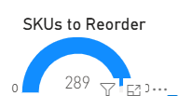
ASSESSING CURRENT INVENTORY PRACTICES
“This section looks at our current stock levels. From the dashboard, we see the total stock quantity and its monetary value. By comparing current stock against maximum allowed levels, I identified SKUs that are overstocked, increasing carrying costs, and others that are understocked, posing stock-out risks.”
INVENTORY ANALYSIS
IDENTIFYING BOTTLENECKS

Slide 7

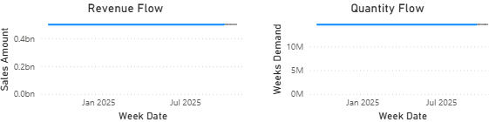

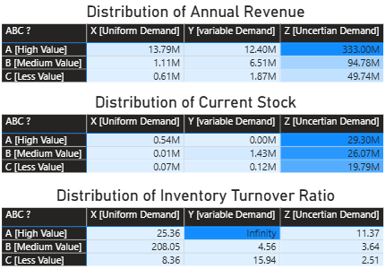

ASSESSING TECHNOLOGY USE
UNDERSTANDING DEMAND PATTERNS

Slide 8
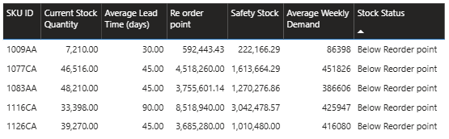
OPTIMIZING INVENTORY LEVELS
SAFETY STOCK MANAGEMENT
REORDER POINT CALCULATION
INVENTORY TURNOVER IMPROVEMENT

Slide 9
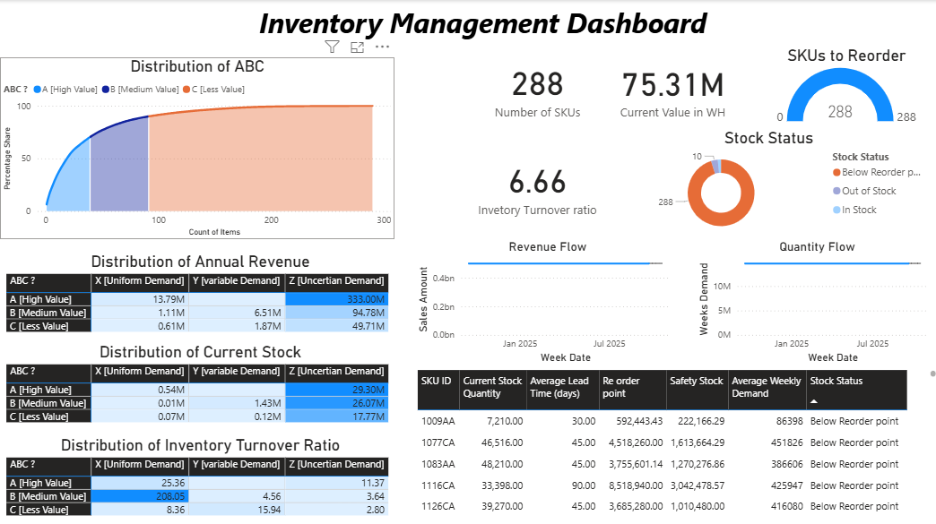
MONITORING

Slide 10
REPORTING
Power BI reporting provides ongoing monitoring of key metrics:
Revenue generated from inventory.
Inventory turnover ratio.
Safety stock coverage in weeks.
Standard deviation to measure demand variability.
This ensures decisions are data-driven, proactive, and transparent.

Slide 11

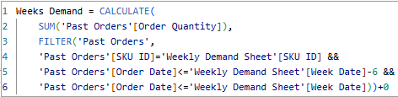


DAX CALCULATIONS
XYZ ? = if(Stock[CV rank]<=0.2*max(Stock[CV rank]),"X [Uniform Demand]",if(Stock[CV rank]<=0.5*max(Stock[CV rank]),"Y [variable Demand]","Z [Uncertian Demand]"))

Slide 12
THANK YOU

